Slide 1
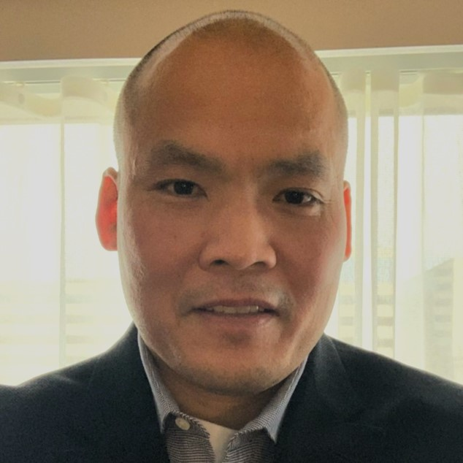
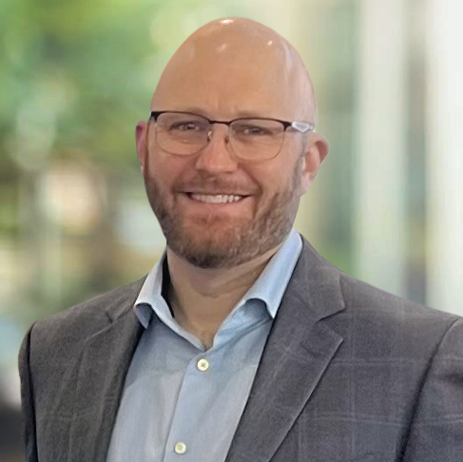
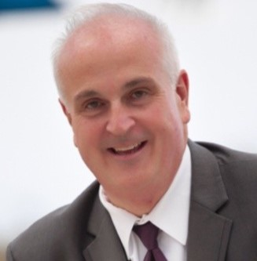
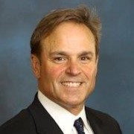
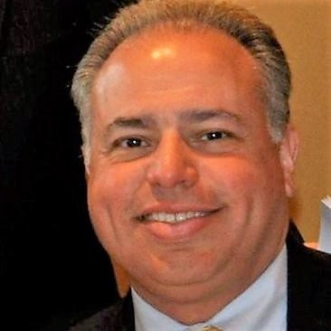
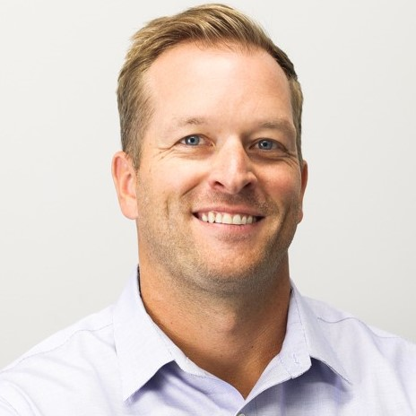
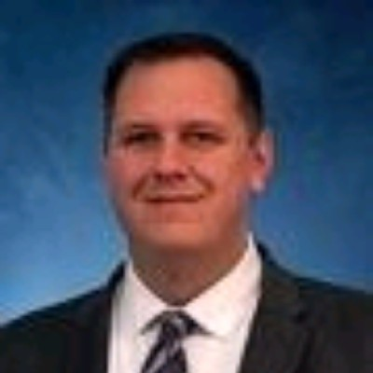
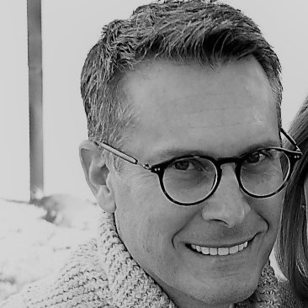
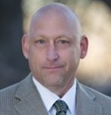
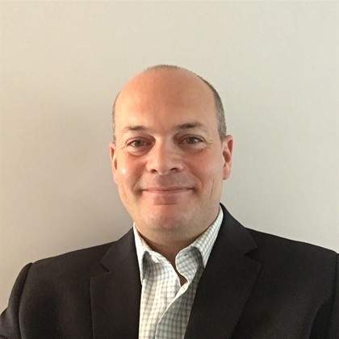
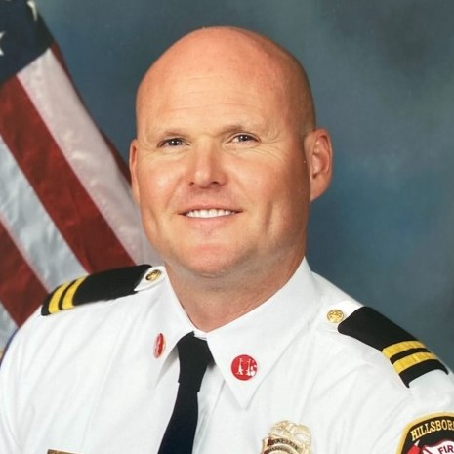
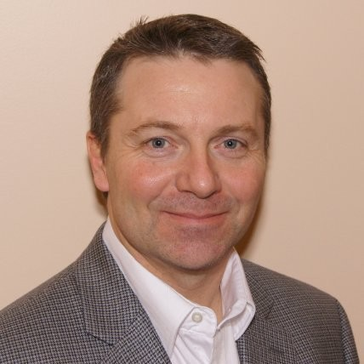
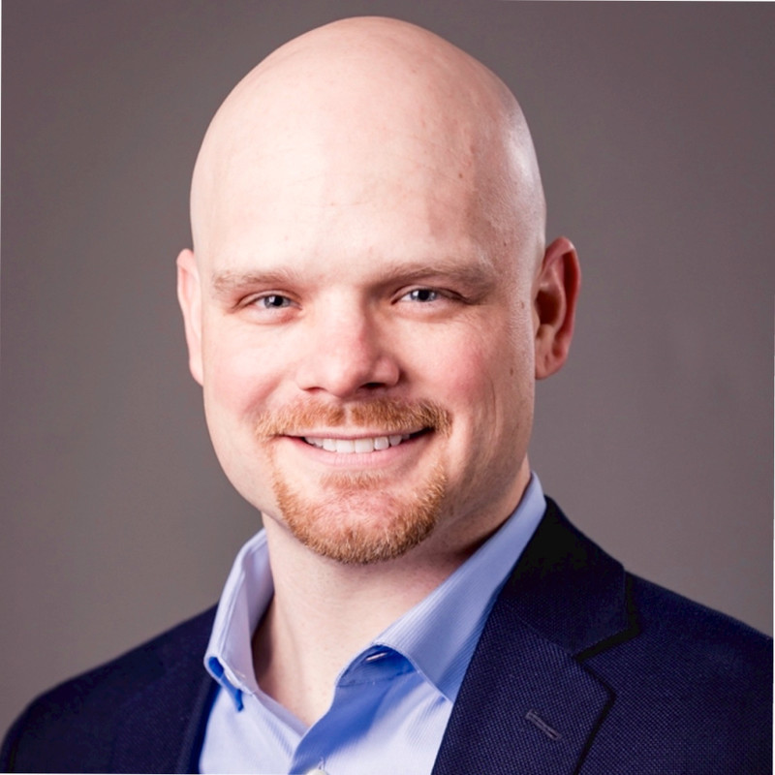
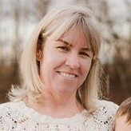

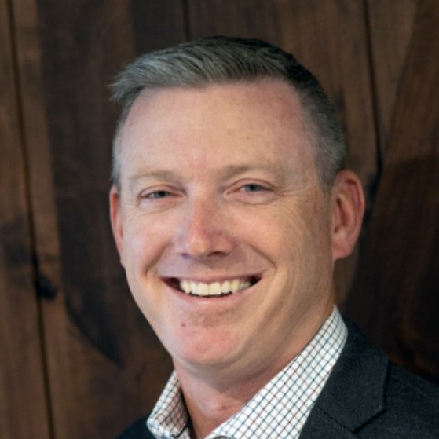
Semtech AirLink Enterprise Sales Team
Hieu Duong
Sr. Director, Global Sales
(503) 708-1774
hduong@semtech.com
Tony Battaglia
Director, AirLink Sales West
(949) 870-2894
abattaglia@semtech.com
Dan Robinson
Director, AirLink Sales East
(904) 226-4950
drobinson@semtech.com
Northern California, Nevada
Jeff Maxoutopoulis
(650) 218-3491
jmaxoutopoulis@semtech.com
Northeast
Joe Venturini
(973) 610-6257
jventurini@semtech.com
Southern California, Hawaii
OPEN
Contact: Tony Battaglia
(949) 870-2894
abattaglia@semtech.com
Northwest / Dakotas
Zach Lane
(986) 269-7332
zlane@semtech.com
Mid Atlantic
Ben Nelson
(443) 617-2283
bnelson@semtech.com
South Central/TOLA
Rance Best, Public Sector
(405) 921-7395
rbest@semtech.com
Plains & Southwest
Tim Jaeger
(303) 588-9524
tjaeger@semtech.com
Sean McGuire
Director, AirLink Sales Canada
(647) 207-8414
smcguire@semtech.com
Southeast
Rich Borowiec
(813) 205-7302
rborowiec@semtech.com
Midwest
Don Miller
(763) 267-5594
dmiller@semtech.com
South Central/TOLA
Cody Brown, Commercial
(469) 389-8748
cbrown@semtech.com
Inside Sales West
Caitlin Berndt
(778) 809-2907
cberndt@semtech.com
Canada
OPEN
Contact: Sean McGuire
(647) 207-8414
smcguire@semtech.com
Inside Sales East
Bonnie Lau
(604) 910-2696
blau@semtech.com
Federal
Grant Kyle
(720) 616-2916
gkyle@semtech.com
Notes:
Stole Rob's format to be consistent....

Slide 2
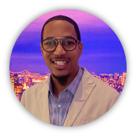
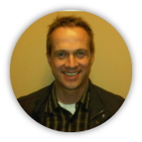
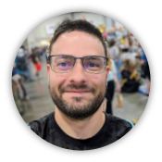
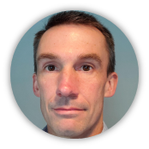
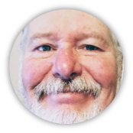
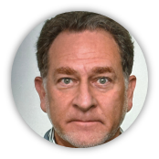
Semtech AirLink Field Sales Engineer Team
Semtech AirLink Field System Engineering Team
Hieu Duong
Sr. Director, Global Sales
(503) 708-1774
hduong@semtech.com
Christopher Baulckim
Sr. Manager, Pre-Sales Engineering
cbaulckim@semtech.com
+1 (770) 325-0762
Canada
Barry Landry
blandry@semtech.com
+1 (902) 832-1345
Northeast
John Blouin
jblouin@semtech.com
+1 (617) 939-4344
Northwest / Dakotas
Alex Harrison
aharrison@semtech.com
+1 (719) 257-4790
Federal
Plains & Southwest
Northern California, Nevada
OPEN
Christopher Baulckim
cbaulckim@semtech.com
+1 (770) 325-0762
Midwest
Bryant Christensen
bchristensen@semtech.com
+1 (616) 560-6953
Southern California, Hawaii
South Central/TOLA
Barry Landry
blandry@semtech.com
+1 (902) 832-1345
Southeast
Armen Tsouroukdissian
armen@semtech.com
+1 (954) 644-2746
Atlantic
Notes:
Stole Rob's format to be consistent....
sales headcount in the west, and for an FSE in the south central US

