Slide 1
AIrlink® Brag sheet
2024

Slide 2
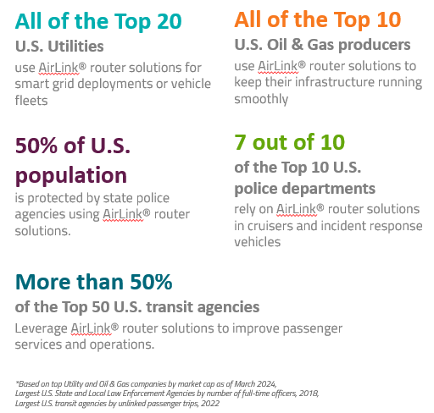
Proven Expertise and Innovation
With over 30 years of wireless expertise and a foundation built on innovation, Semtech is the go-to expert for mission-critical connectivity, trusted by leading industrial and public safety organizations worldwide.
The statements in this document are based on an internal study conducted by Semtech in March 2024 and are believed to be accurate as of this date.

Slide 3

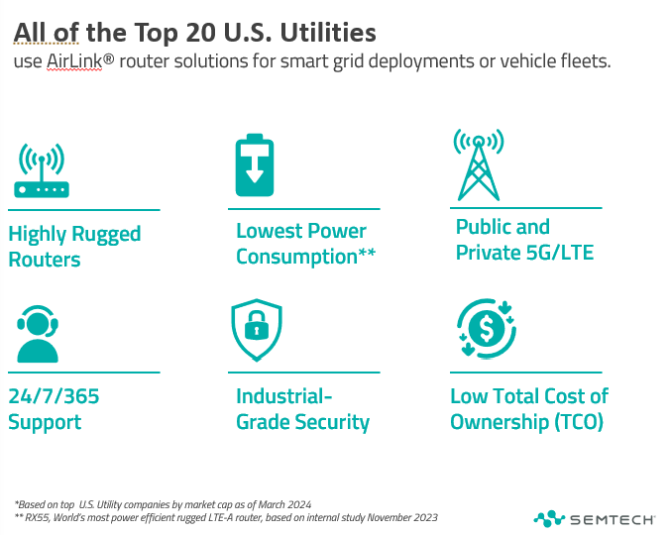
Notes:
HIGHLY-RUGGEDIZED DESIGN to withstand tough harsh and hazardous environments
ULTRA-LOW POWER Pro Compact routers consume less than 1 Watt in idle mode and are specifically designed to operate on limited power sources
VERSATILE SOLUTIONS supporting both private and public 5G and LTE networks to enhance grid’s longevity and reliability
ADVANCED NETWORK MANAGEMENT simplifies router deployment and enables remote monitoring, management and upgrading of all devices
INDUSTRIAL-GRADE SECURITY with unrestricted access to security patches, network and carrier-agnostic VPN solution and hybrid cloud management option

Slide 4

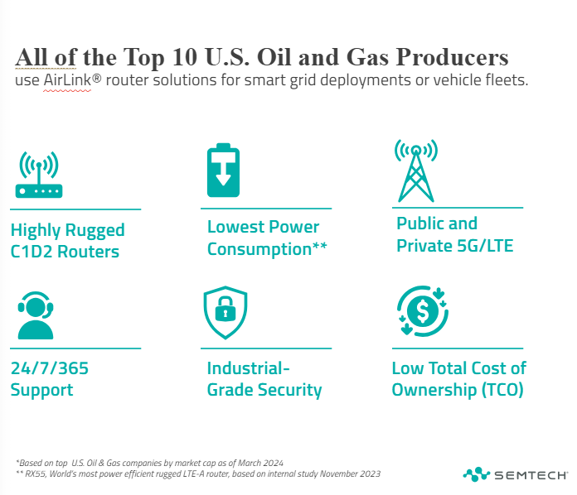
Notes:
HIGHLY-RUGGEDIZED DESIGN to withstand tough harsh and hazardous environments
ULTRA-LOW POWER Pro Compact routers consume less than 1 Watt in idle mode and are specifically designed to operate on limited power sources
VERSATILE SOLUTIONS supporting both private and public 5G and LTE networks to enhance grid’s longevity and reliability
ADVANCED NETWORK MANAGEMENT simplifies router deployment and enables remote monitoring, management and upgrading of all devices
INDUSTRIAL-GRADE SECURITY with unrestricted access to security patches, network and carrier-agnostic VPN solution and hybrid cloud management option

Slide 5

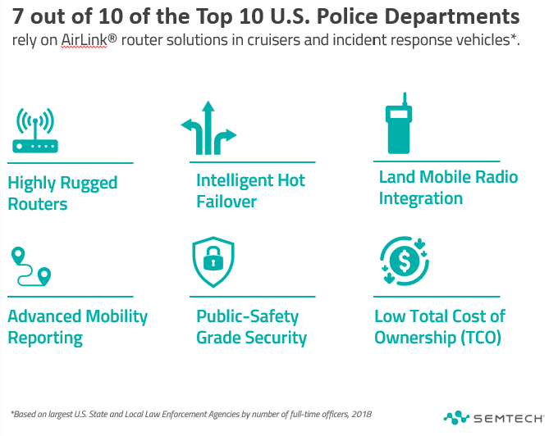
Notes:
HIGHLY-RUGGEDIZED DESIGN to withstand tough vehicle environments
COGNITIVE WIRELESS Intelligently steer traffic across multiple links with mobility-centric selection criteria e.g. vehicle speed, roaming, to enable maximum reliability
LAND MOBILE RADIO (LMR) INTEGRATION for extended coverage and expedite radio upgrades
ADVANCED MOBILITY REPORTING Advanced coverage and fleet reporting to monitor your network and vehicles
PUBLIC SAFETY-GRADE SECURITY with FIPS 140-2 compliant VPN and hybrid cloud management option

Slide 6

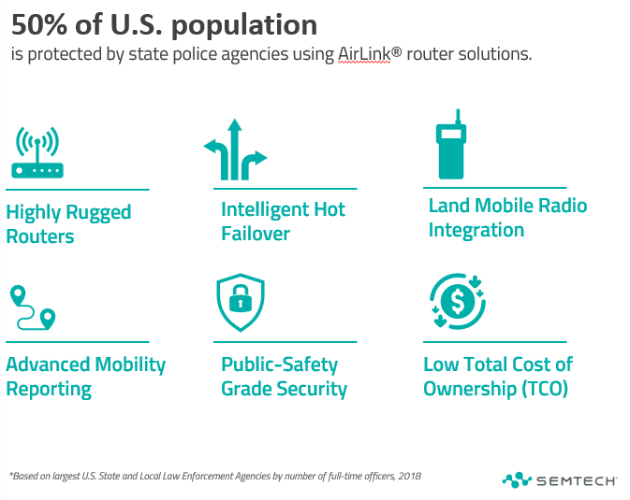
Notes:
HIGHLY-RUGGEDIZED DESIGN to withstand tough vehicle environments
COGNITIVE WIRELESS Intelligently steer traffic across multiple links with mobility-centric selection criteria e.g. vehicle speed, roaming, to enable maximum reliability
LAND MOBILE RADIO (LMR) INTEGRATION for extended coverage and expedite radio upgrades
ADVANCED MOBILITY REPORTING Advanced coverage and fleet reporting to monitor your network and vehicles
PUBLIC SAFETY-GRADE SECURITY with FIPS 140-2 compliant VPN and hybrid cloud management option

Slide 7

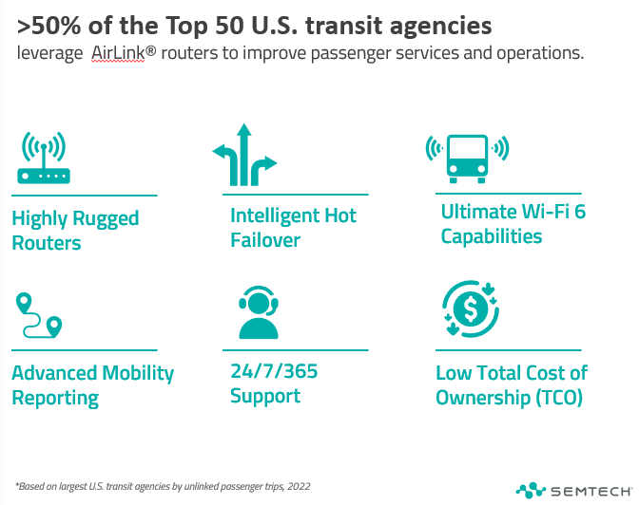
Notes:
HIGHLY-RUGGEDIZED DESIGN to withstand tough vehicle environments
COGNITIVE WIRELESS* Intelligently steer traffic across multiple links with mobility-centric selection criteria e.g. vehicle speed, roaming, to enable maximum reliability
ULTIMATE WI-FI 6 CAPABILITIES* Ideal for video offload and passenger Wi-Fi applications
ADVANCED MOBILITY REPORTING Advanced coverage and fleet reporting to monitor your network and vehicles
FORWARD LOOKING SOLUTIONS Modular design* to take advantage of ever-improving technology without ripping out the router

