Slide 1
AIRLINK® application Diagrams
December 2024

Slide 2




Click on picture to go to the relevant section
PUBLIC SAFETY
MOBILITY
INDUSTRIAL
IOT
Law Enforcement
Tactical Command Vehicles
Fire Services
Firefighters Quad
Ambulances
Military Vehicles
Military Tent
Public Transit
Utility Bucket Truck
Utility Van
Mining & Heavy Vehicles
School Bus
Taxi
Power Grid
Wind Power Generation
Pipeline
Water Utility
Agriculture
Construction Site
Manufacturing
Smart Cities
Video Surveillance
EV Charging
Digital Signage
Digital Kiosks
Convenience Store
Retail
Distance Learning

Slide 3
Public safety

Slide 4
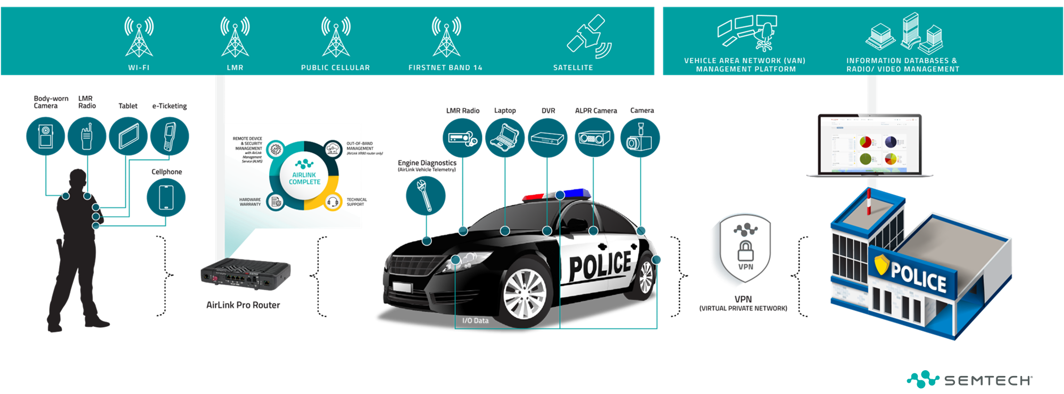
Law Enforcement
Notes:
Maximize responsiveness, teamwork and collaboration
Ensure accountability and transparency with live video feeds
Increase efficiencies with LMR integrations and vehicle monitoring
Increase safety for your officers and citizens

Slide 5
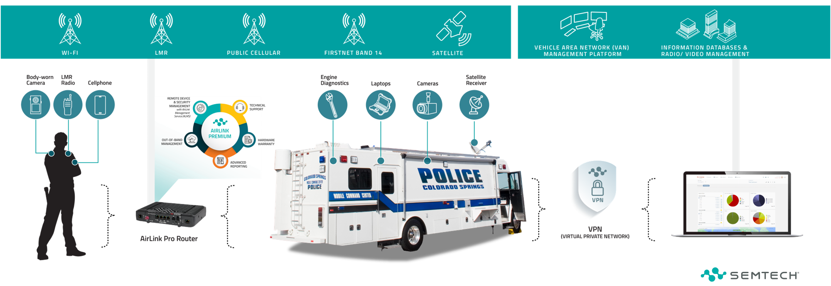
Tactical Command Vehicles

Slide 6
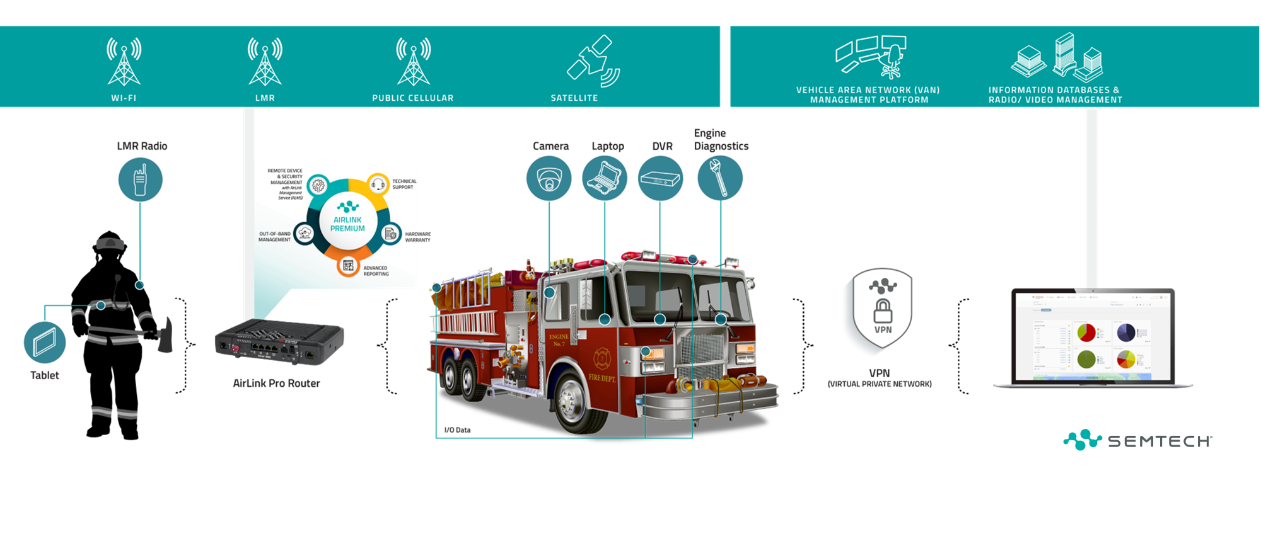
Fire Services
Notes:
Gain reliable, responsive, secure and redundant 5G internet access using rugged, easy to manage routers with excellent support and long life
Increase responsiveness through real-time critical data access including building/room temperature, hydrant location, security footage and floor plans
Improve safety and efficiency with new technologies such as augmented reality (AR) to see through smokey buildings and find victims faster, as well as implementing fire-fighting robots

Slide 7
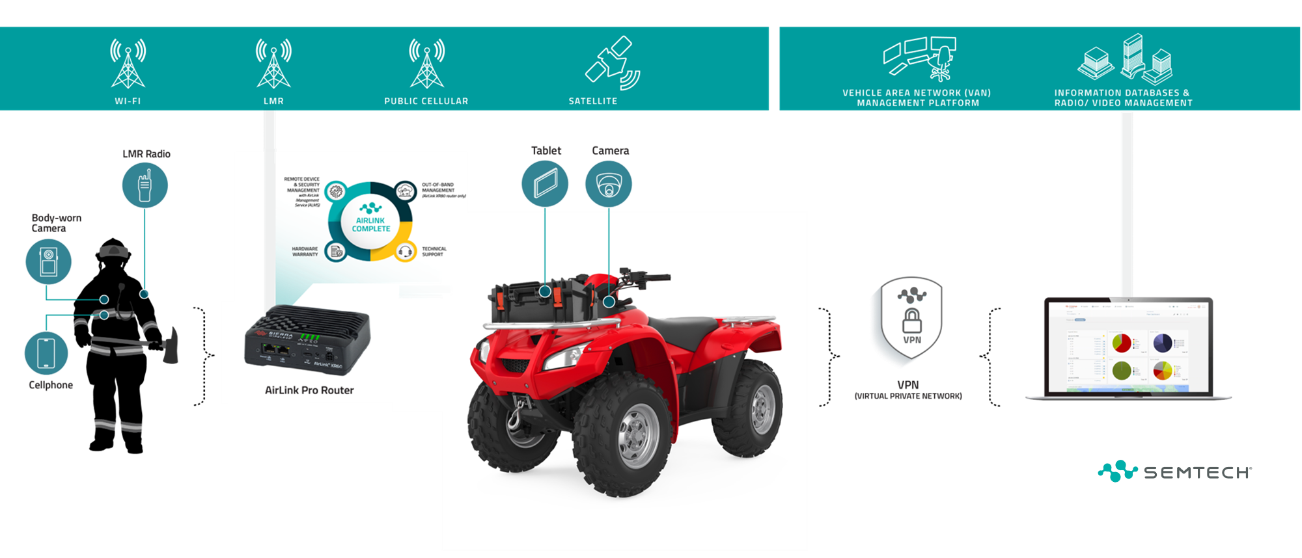
Firefighters Quad
Notes:
Gain reliable, responsive, secure and redundant 5G internet access using rugged, easy to manage routers with excellent support and long life
Increase responsiveness through real-time critical data access including building/room temperature, hydrant location, security footage and floor plans
Improve safety and efficiency with new technologies such as augmented reality (AR) to see through smokey buildings and find victims faster, as well as implementing fire-fighting robots

Slide 8
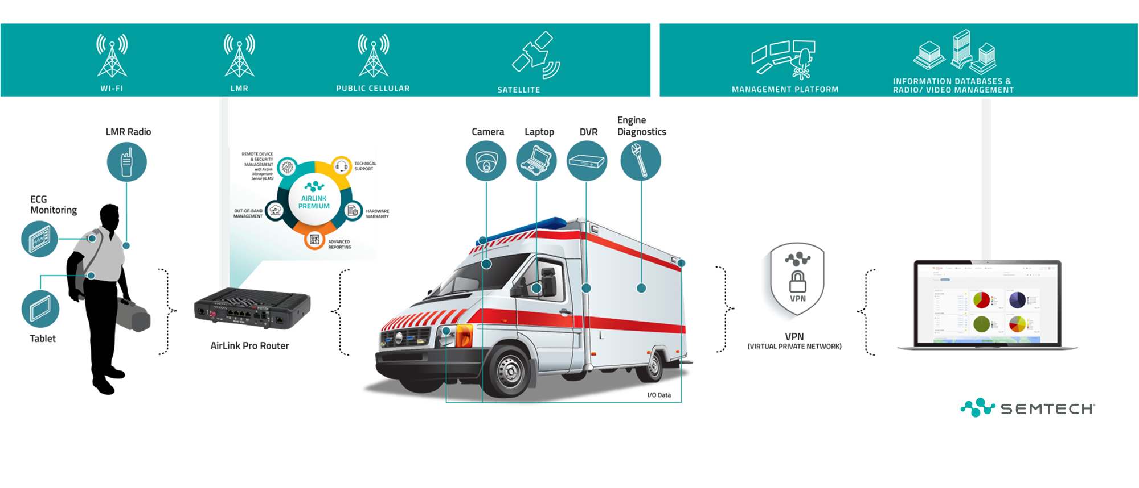
Emergency Medical Services
Notes:
Arrive faster at locations through advanced GNSS navigation
Expedite expert patient care on site through real-time connectivity and live video with ER doctors
Improve responsiveness by quickly accessing electronic patient care records (EPCR)
Deliver real-time patient data from ECG/EKGs and other health monitoring devices while en route to the hospital

Slide 9
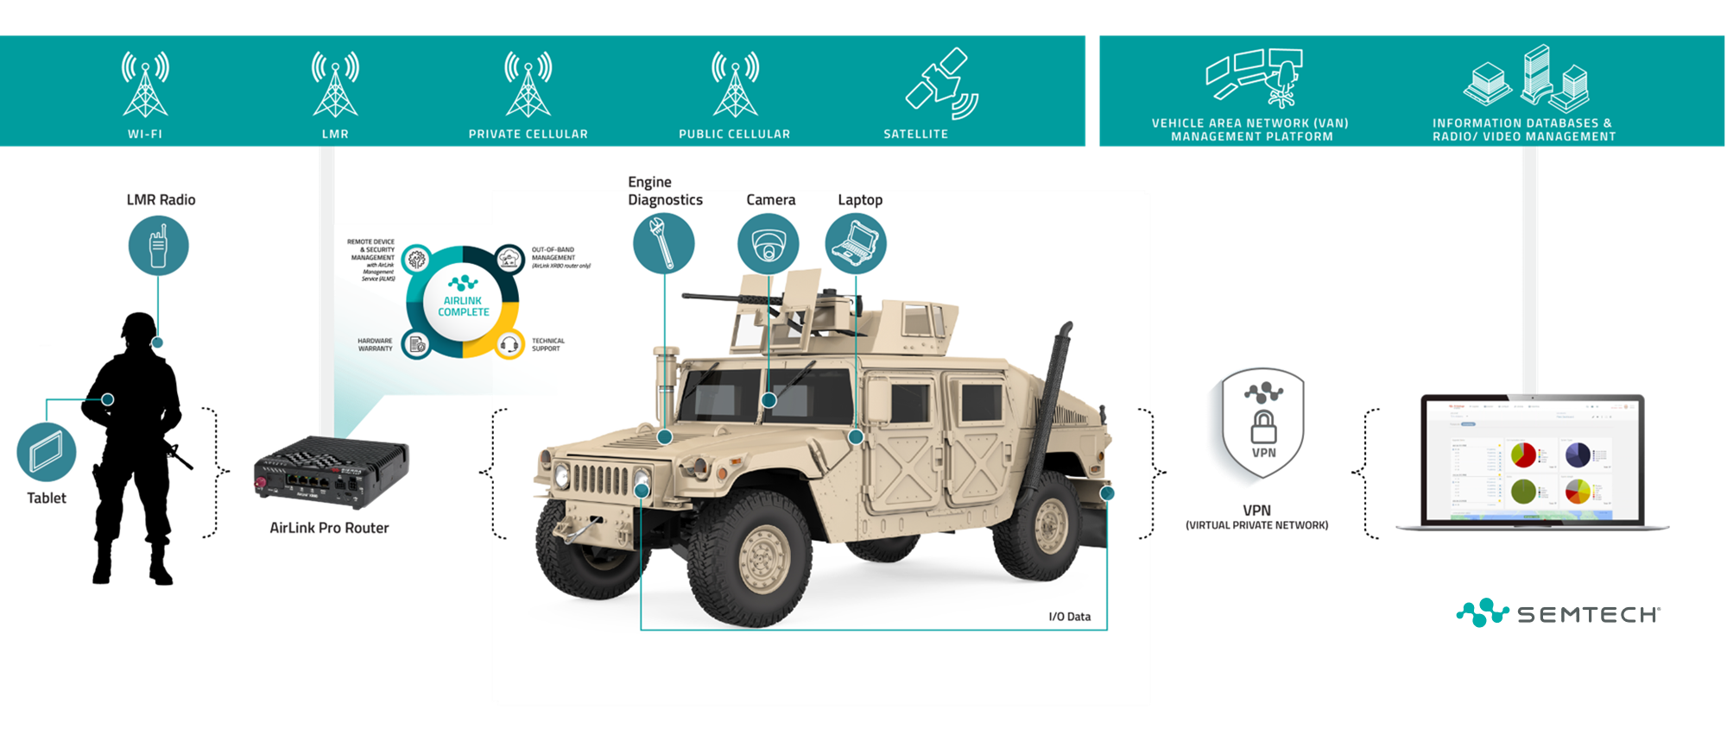
Military vehicle
Notes:
Arrive faster at locations through advanced GNSS navigation
Expedite expert patient care on site through real-time connectivity and live video with ER doctors
Improve responsiveness by quickly accessing electronic patient care records (EPCR)
Deliver real-time patient data from ECG/EKGs and other health monitoring devices while en route to the hospital

Slide 10
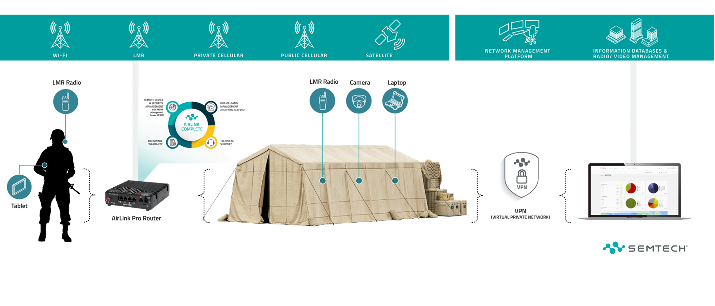
Military tent
Notes:
Arrive faster at locations through advanced GNSS navigation
Expedite expert patient care on site through real-time connectivity and live video with ER doctors
Improve responsiveness by quickly accessing electronic patient care records (EPCR)
Deliver real-time patient data from ECG/EKGs and other health monitoring devices while en route to the hospital

Slide 11
MOBILITY

Slide 12
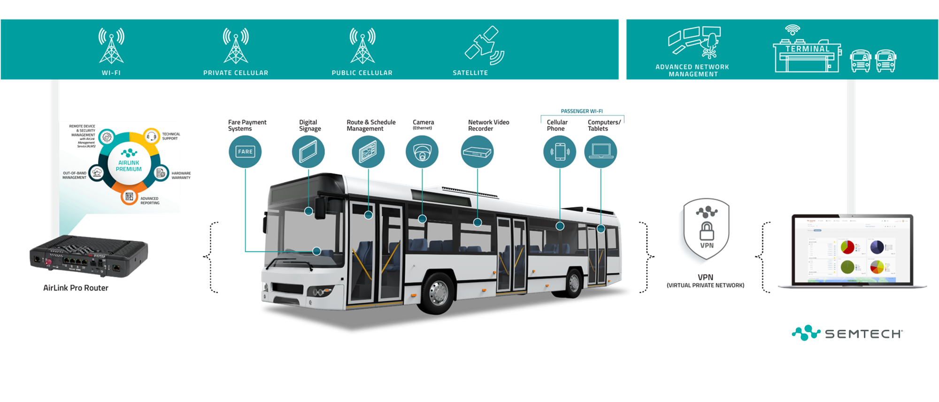
Public Transit & Rail
Notes:
Help ensure driver and passenger safety with live video
Increase efficiency and security with separate networks for passenger Wi-Fi and vehicle services
Simplify integration with fare payment systems, digital signage and video
Improve passenger flow through real-time passenger monitoring

Slide 13
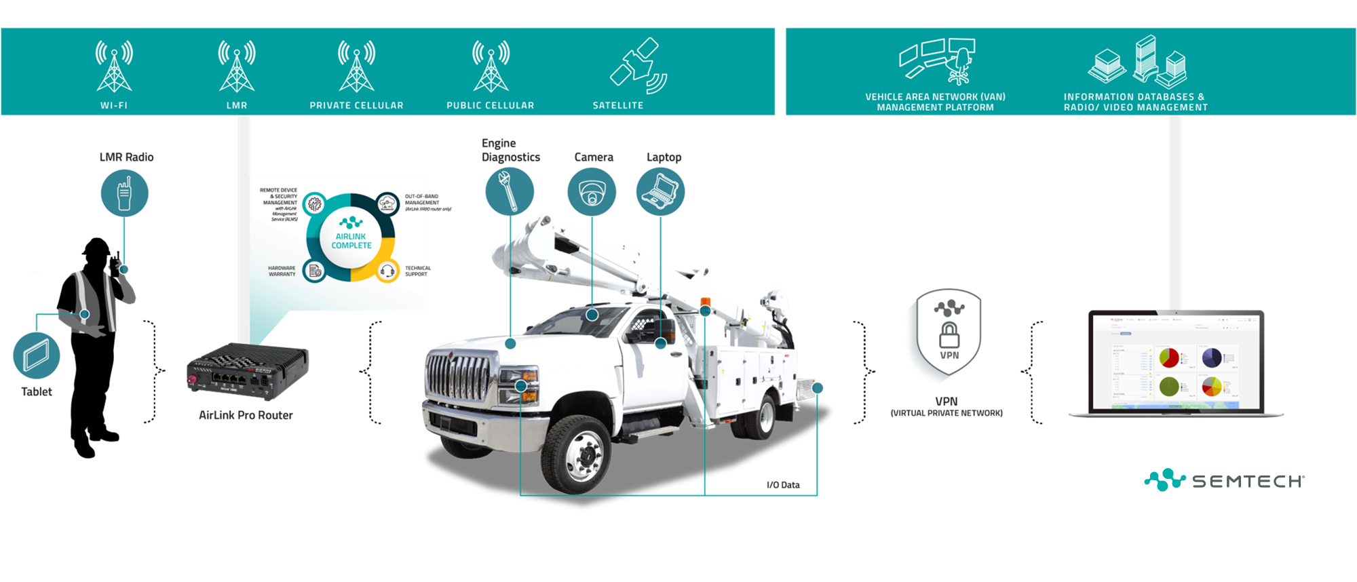
Utility Bucket Trucks
Notes:
Increase the safety and efficiency of workers and assets
Improve responsiveness and teamwork
Improve inter-organizational communication during disasters
Get power restored faster through real-time data and situational analysis information

Slide 14
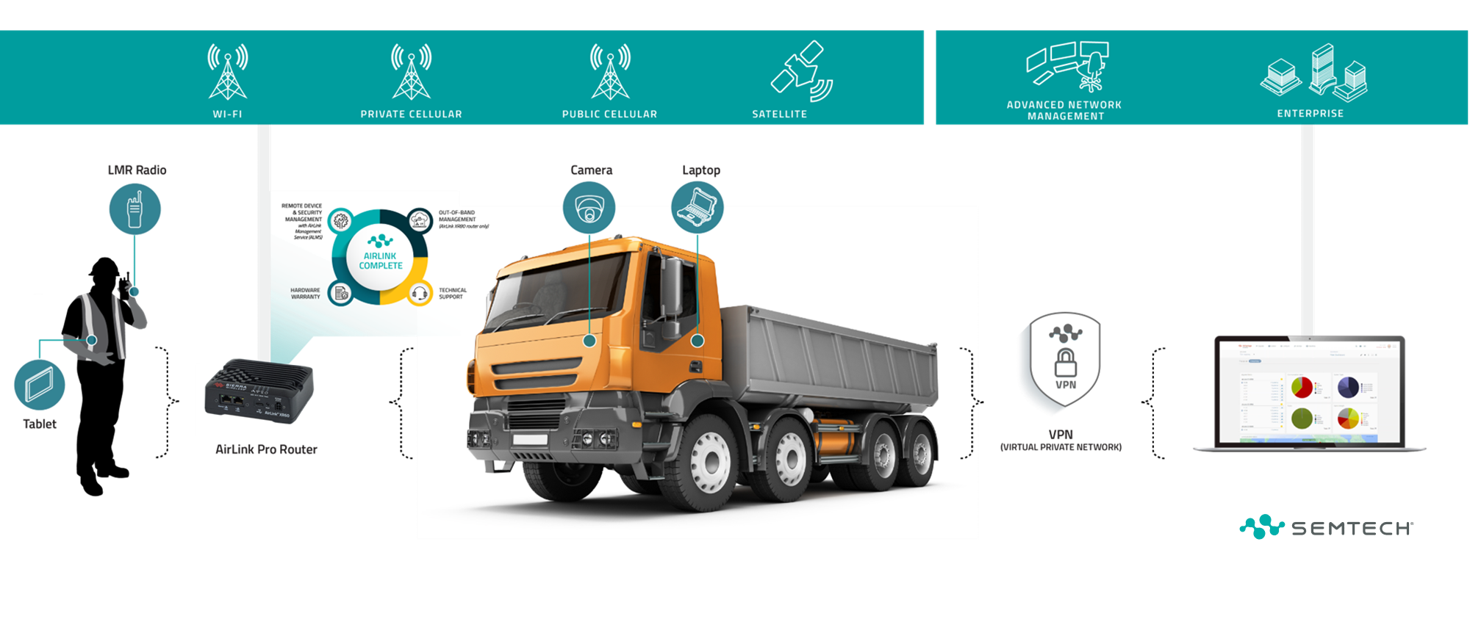
Utility Vans and Trucks

Slide 15
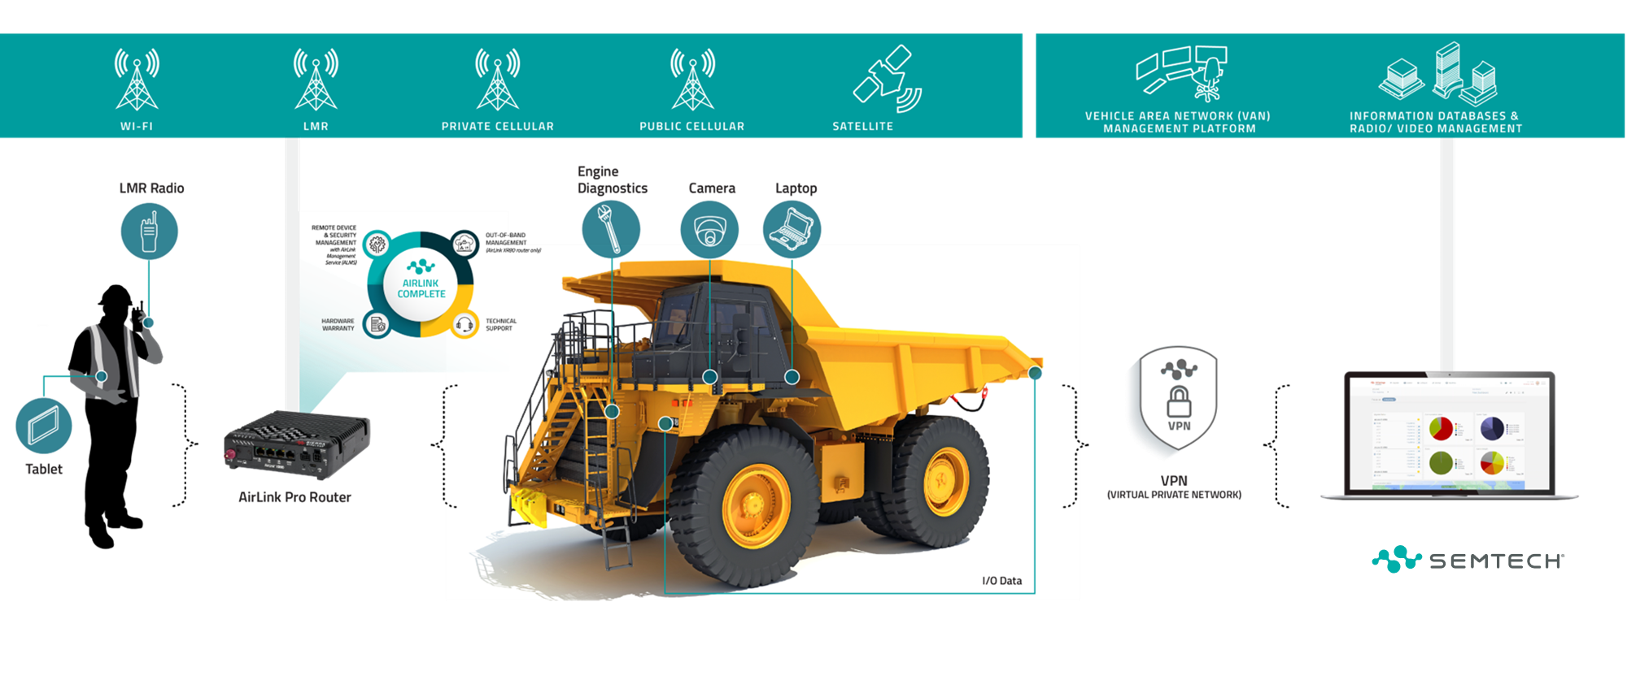
Mining & Heavy Vehicles
Notes:
Increase the safety and efficiency of workers and assets
Improve responsiveness and teamwork
Improve inter-organizational communication during disasters
Get power restored faster through real-time data and situational analysis information

Slide 16
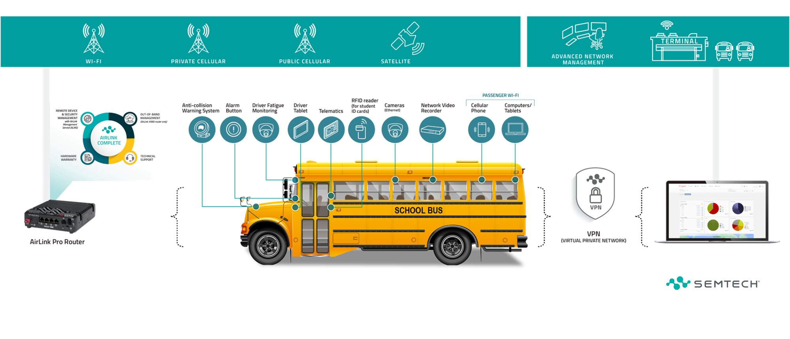
School Buses
Notes:
Improve driver and student safety
Improve overall vehicle safety through real-time system monitoring
Enable students to use high-speed connectivity for doing homework en-route to school
Use buses as super Wi-Fi hotspots for remote learning

Slide 17
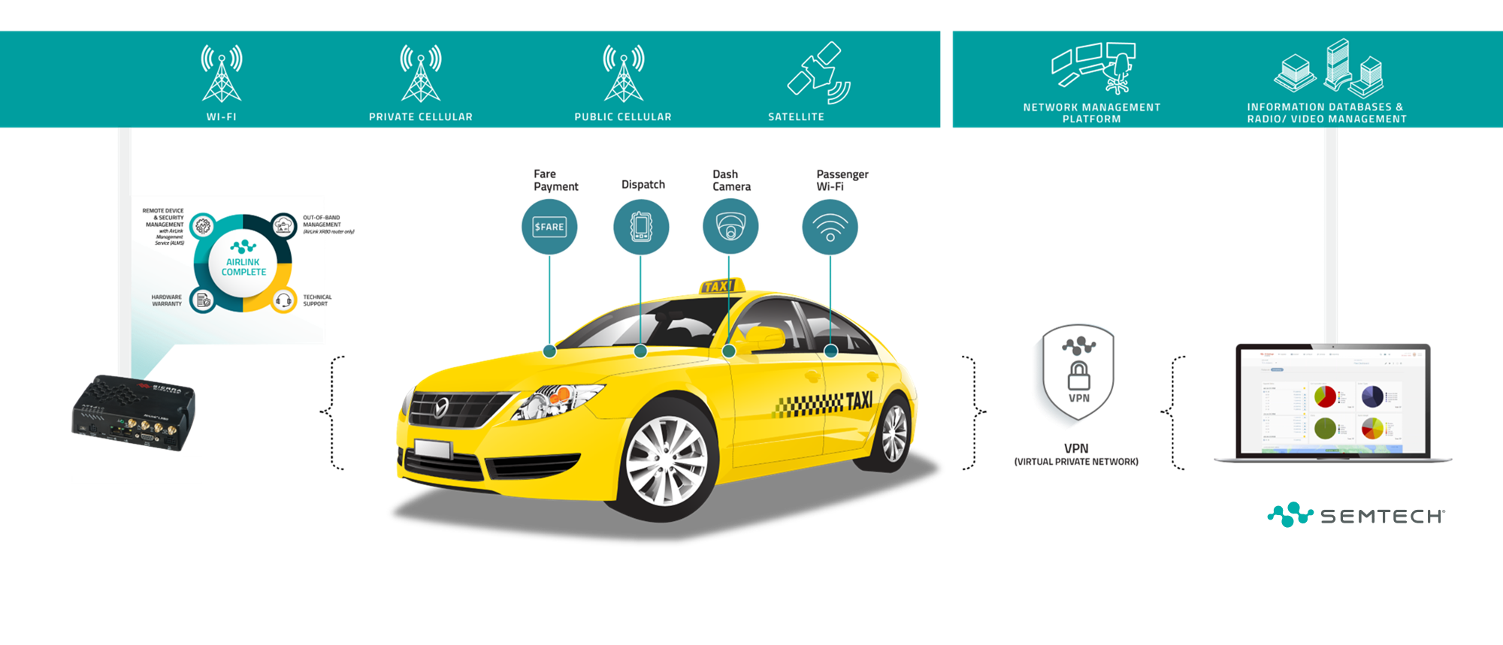
Taxi

Slide 18
INDUSTRIAL

Slide 19
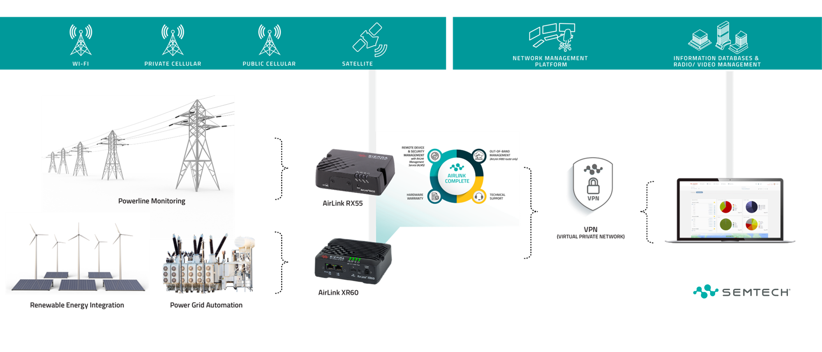
Power Grid Automation

Slide 20
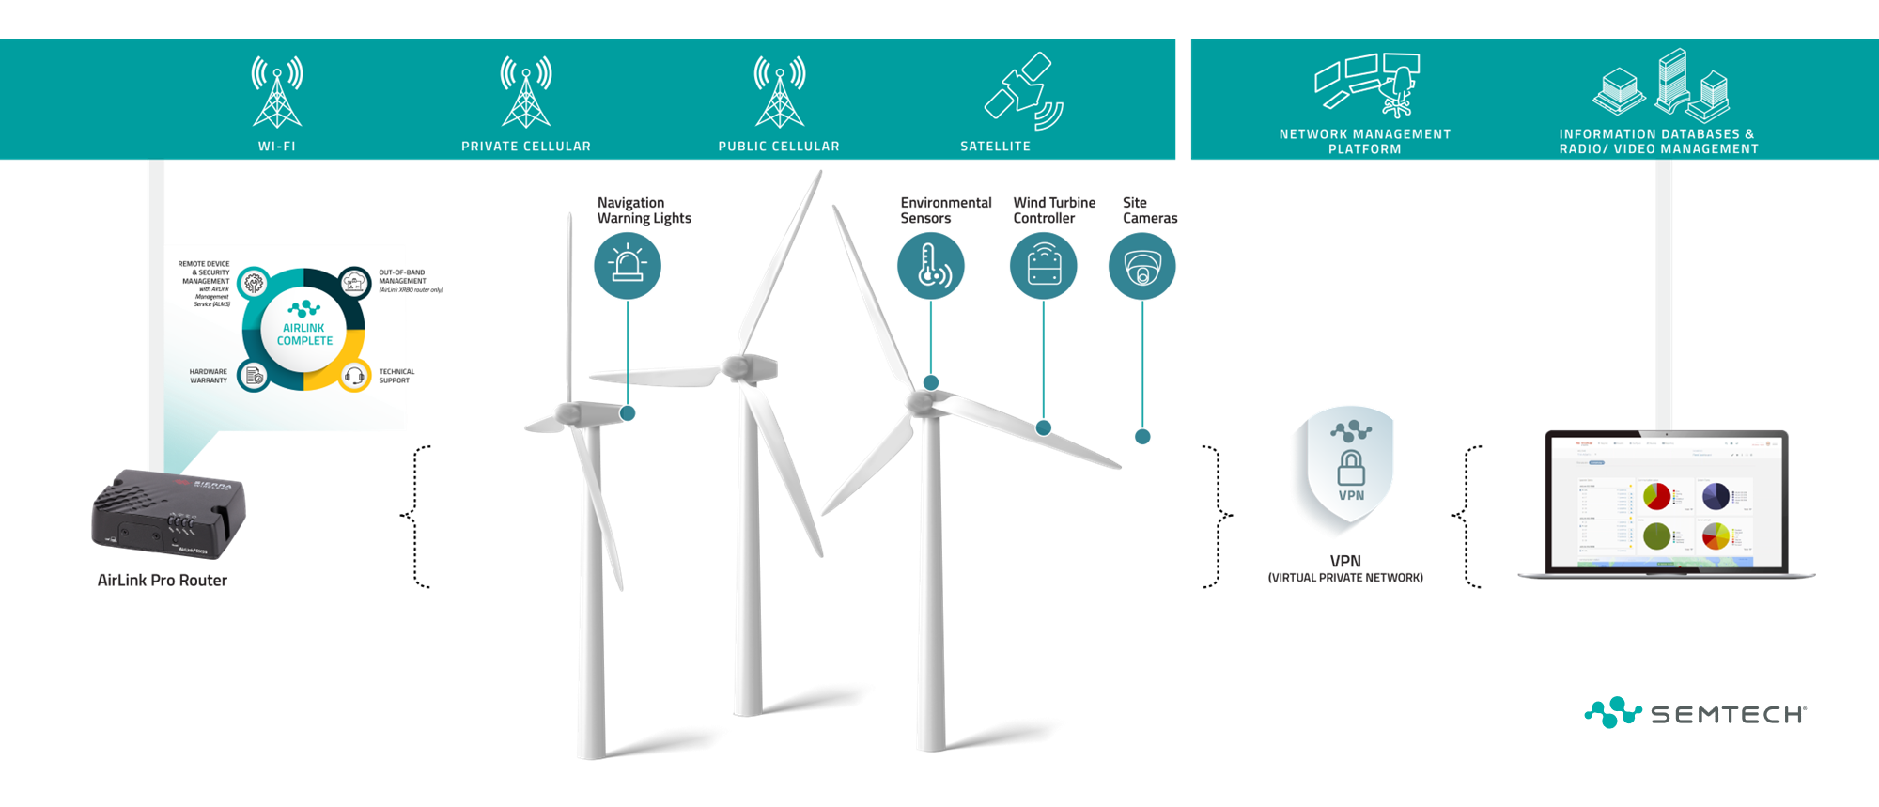
Wind Power Generation

Slide 21
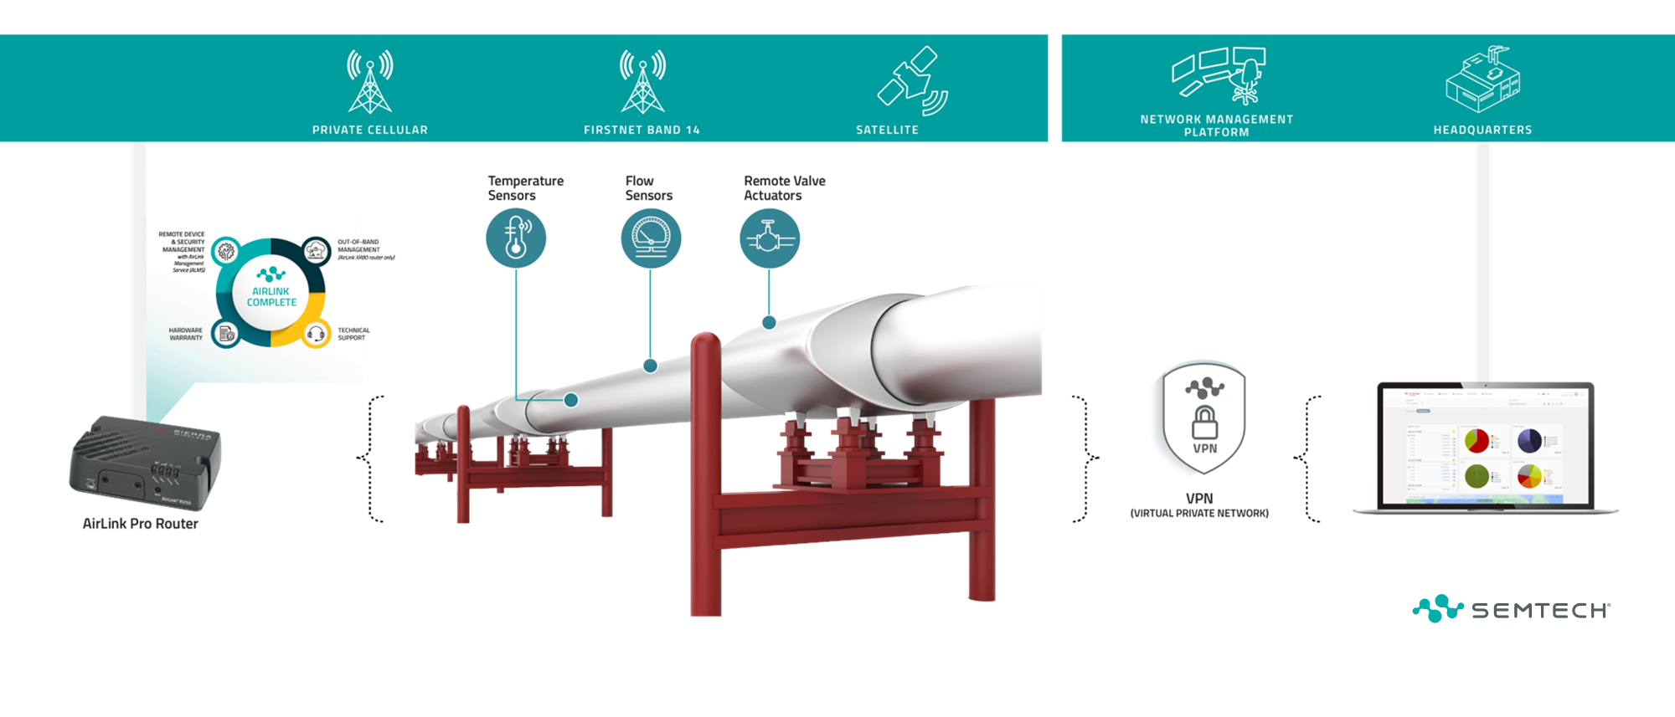
Pipeline

Slide 22
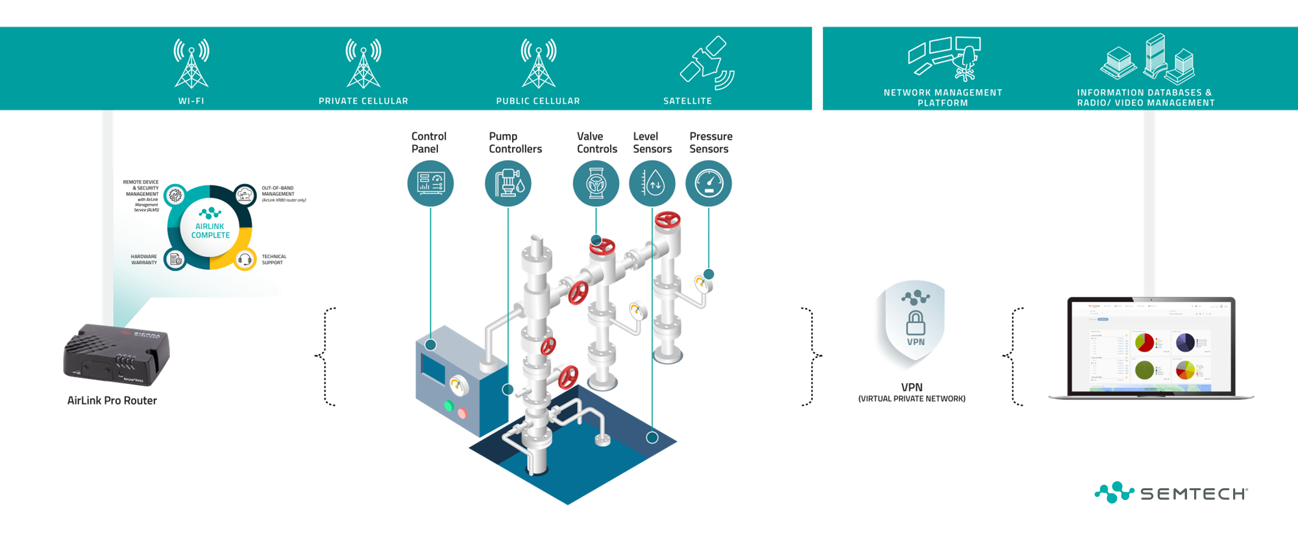
Water Utility

Slide 23
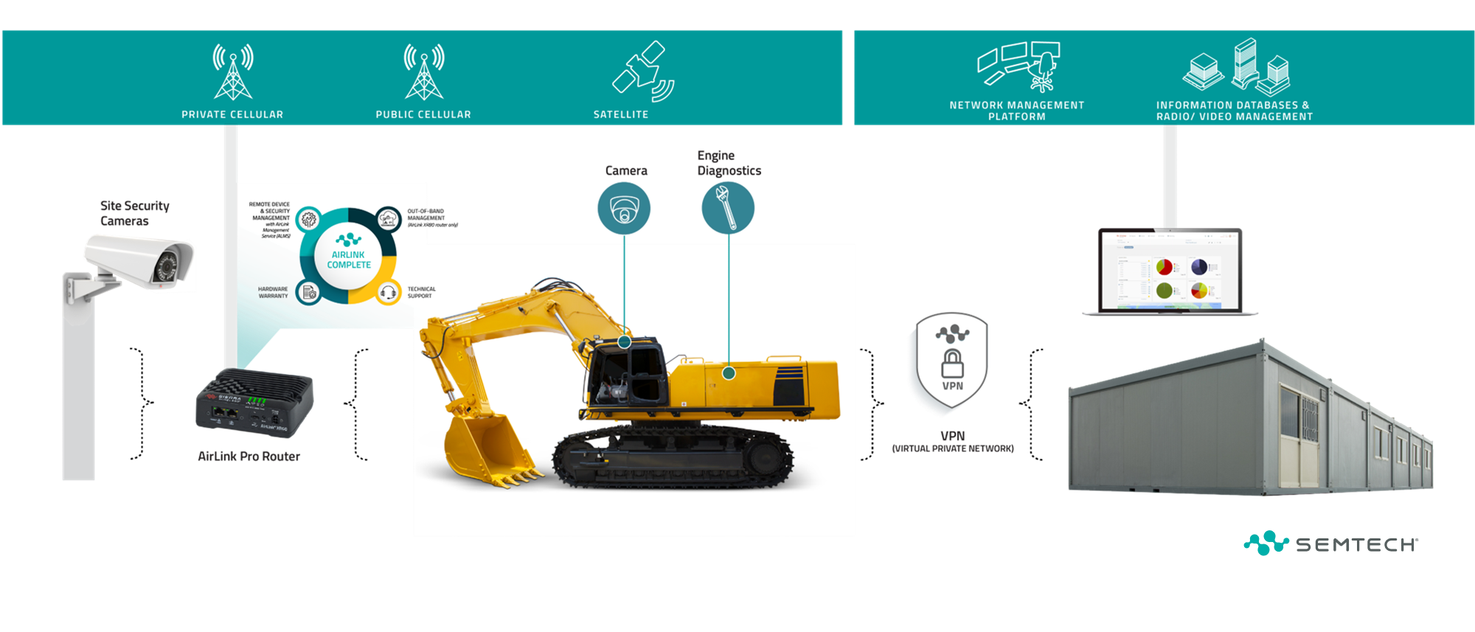
Construction Site
Notes:
Increase the safety and efficiency of workers and assets
Improve responsiveness and teamwork
Improve inter-organizational communication during disasters
Get power restored faster through real-time data and situational analysis information

Slide 24
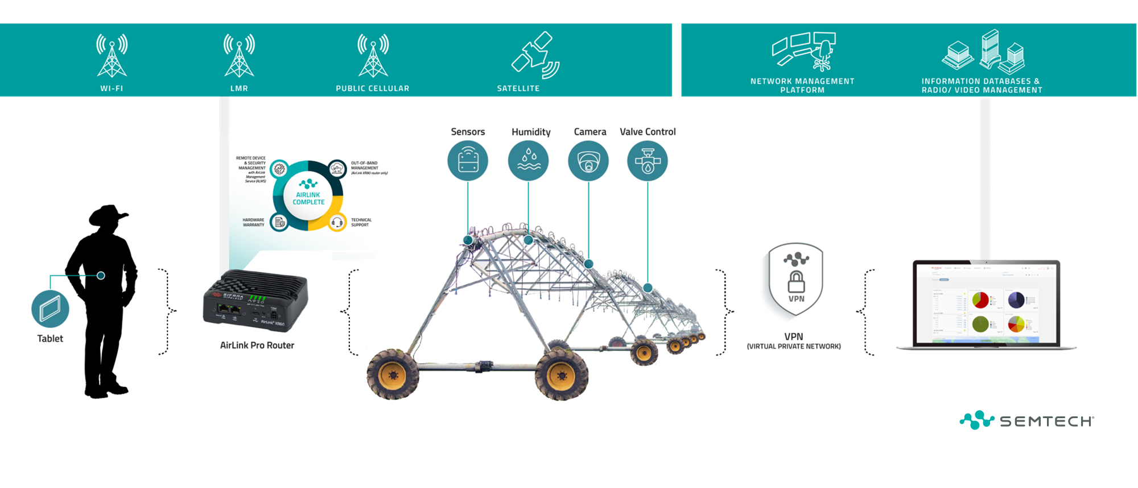
Agriculture
Notes:
Increase the safety and efficiency of workers and assets
Improve responsiveness and teamwork
Improve inter-organizational communication during disasters
Get power restored faster through real-time data and situational analysis information

Slide 25
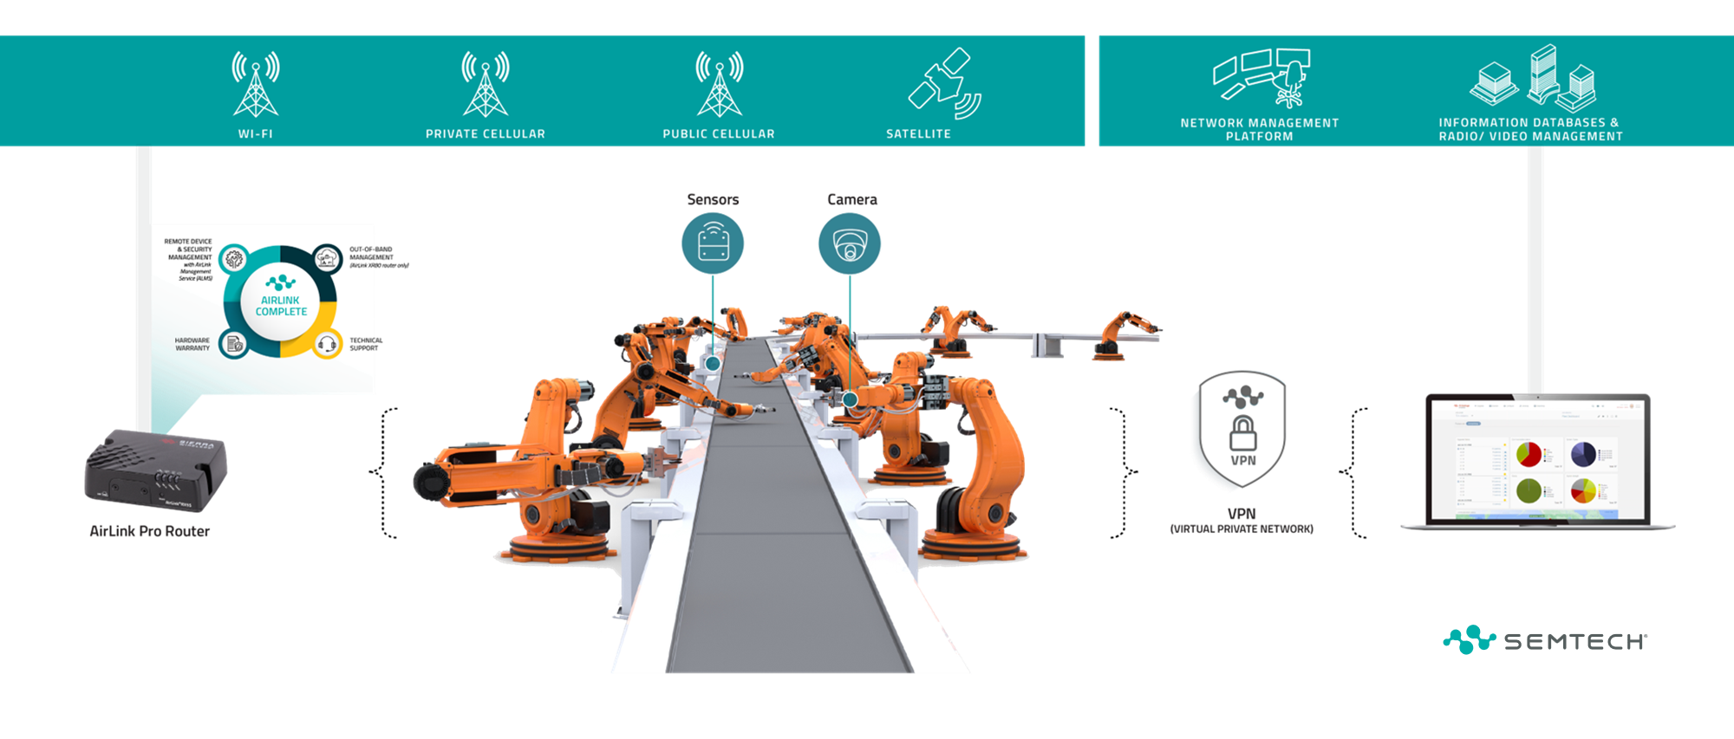
Manufacturing
Notes:
Gain flexibly and cost savings by reliably connecting machinery to cloud-based programmable logic controllers (PLCs)
Improve quality and oversight through real-time video and data monitoring
Ensure security and reliability through implantation of a private cellular network
Gain flexibly and cost savings by reliably connecting machinery to cloud-based programmable logic controllers (PLCs)
Improve quality and oversight through real-time video and data monitoring
Ensure security and reliability through implantation of a private cellular network

Slide 26
IOT

Slide 27
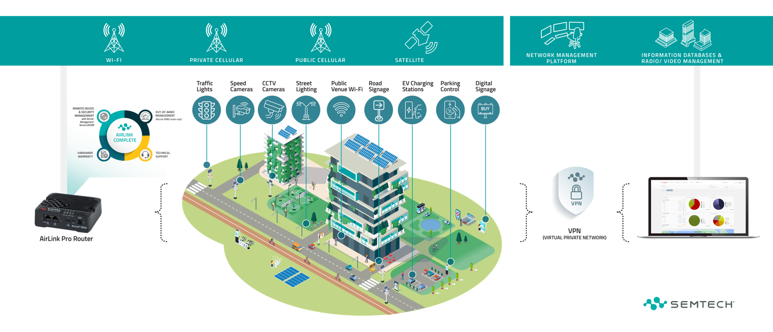
Smart Cities

Slide 28
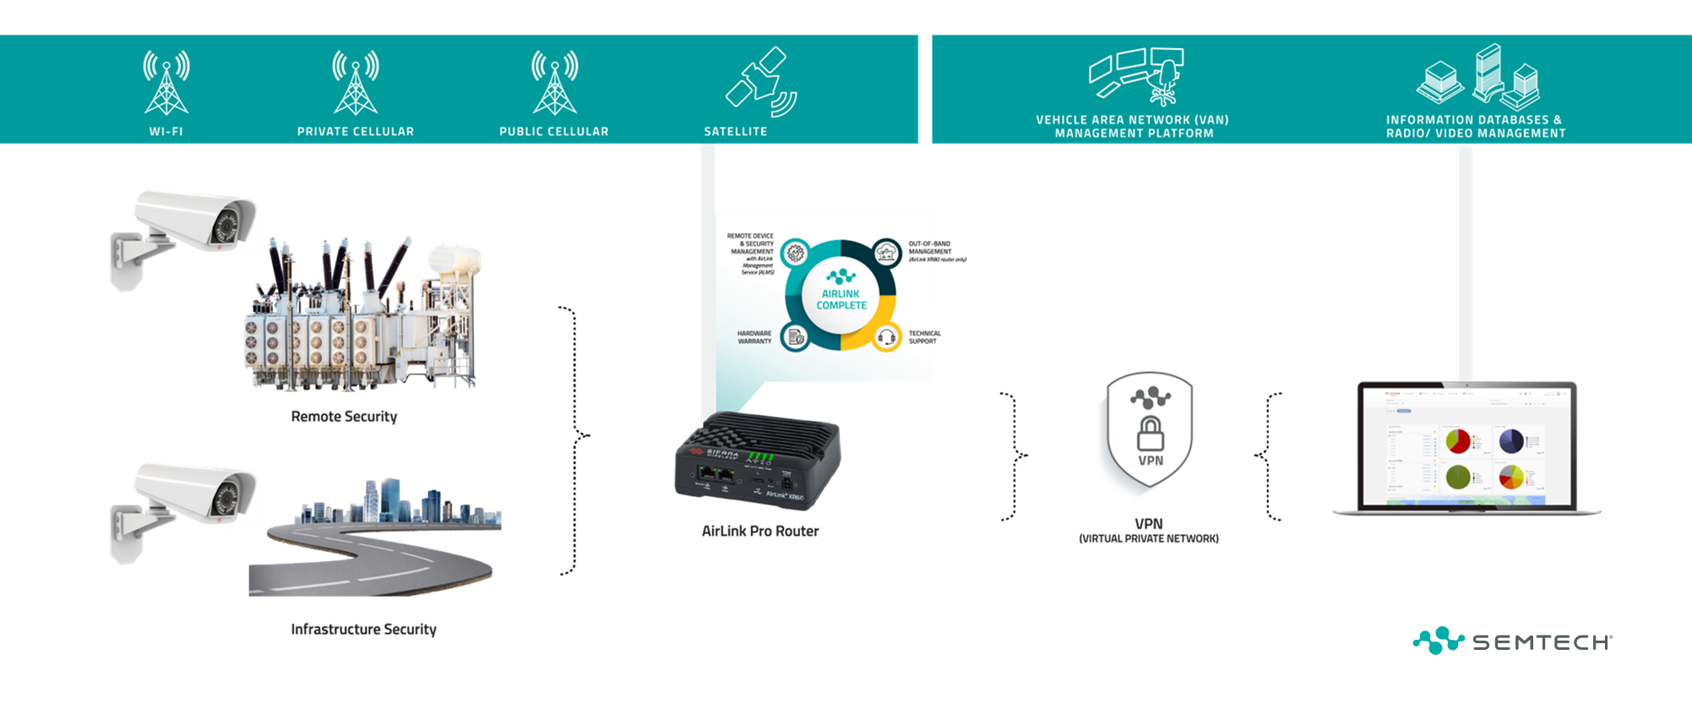
Video Surveillance

Slide 29
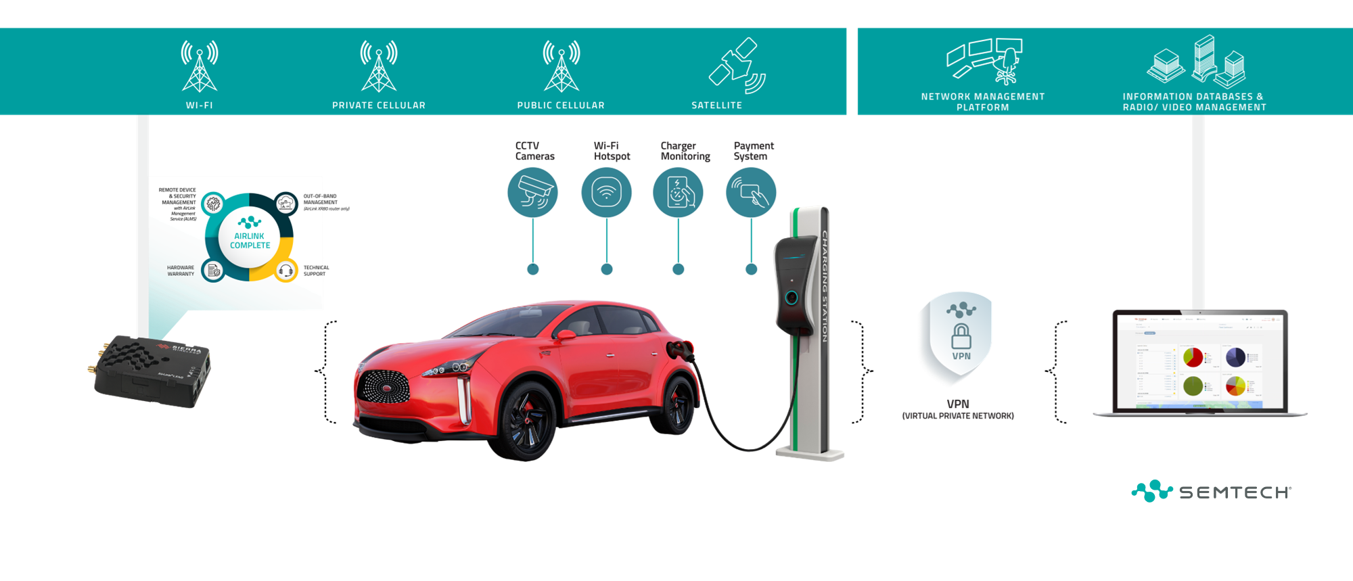
EV Charging

Slide 30
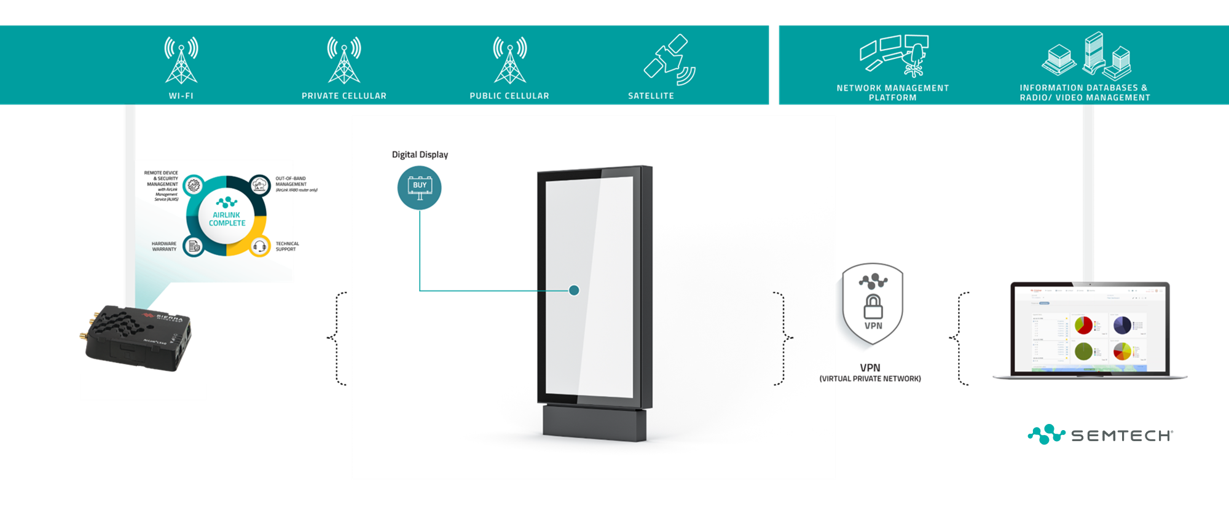
Digital Signage

Slide 31
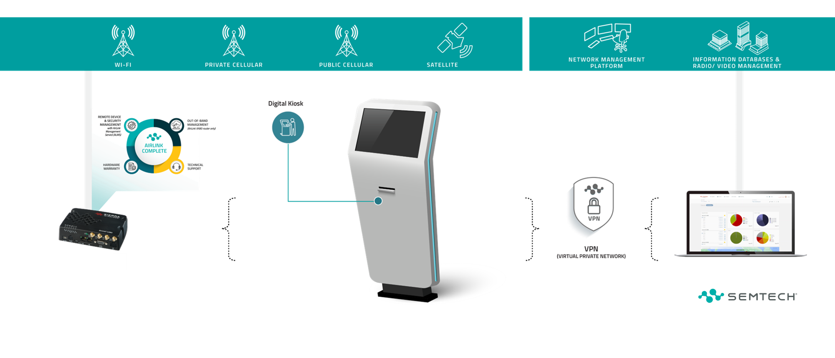
Digital Signage, Kiosks, Parcel Lockers

Slide 32
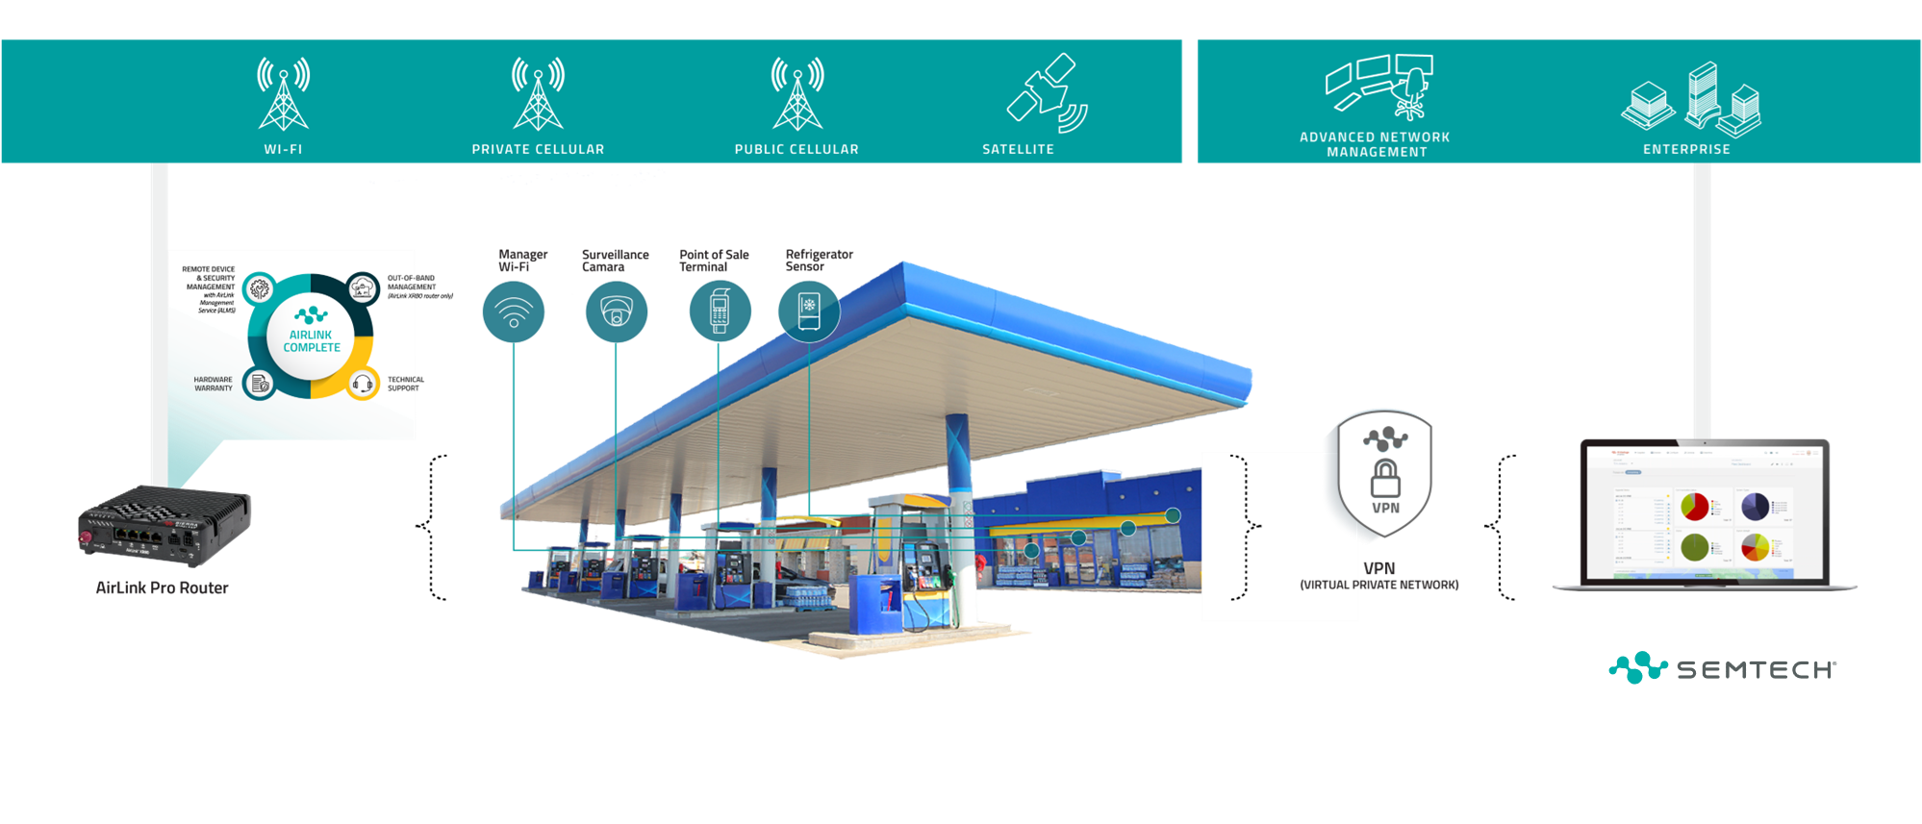
Convenience Store

Slide 33
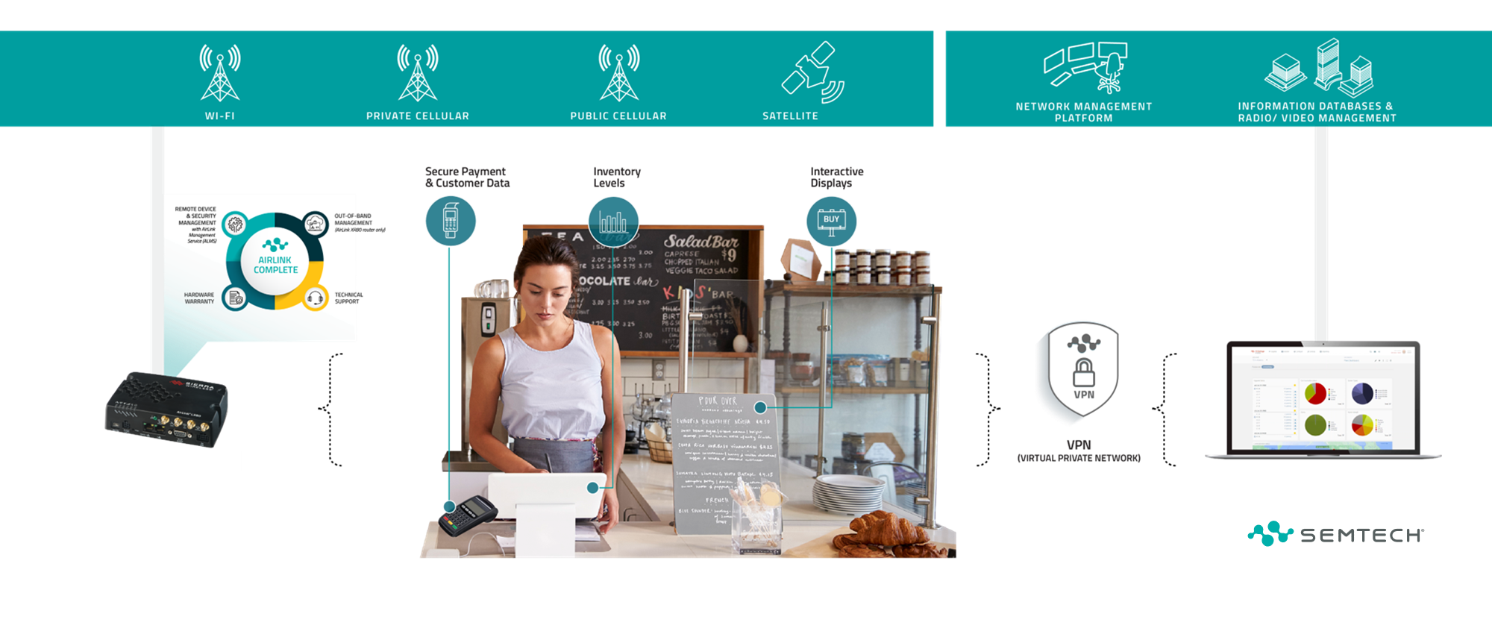
Retail, Branches, Fixed Wireless Access

Slide 34
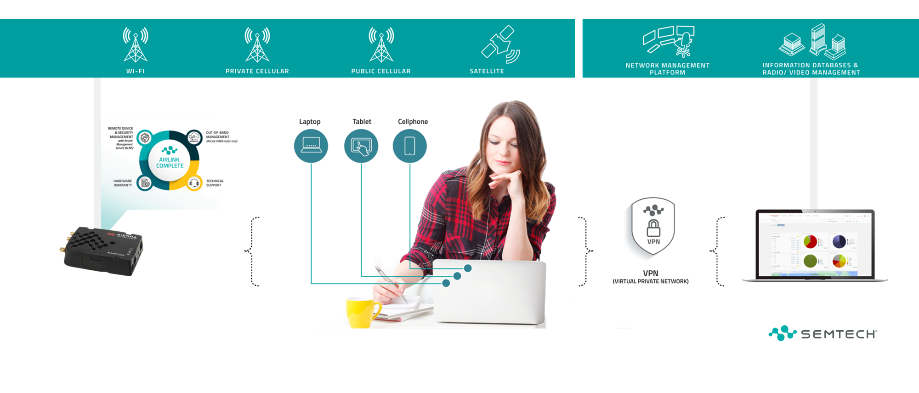
Distance Learning

